Slide 1
Of Light and Lasers
Module:
Nanoscale Measuring of Diffraction Patterns with a Laser
Notes:
This slide show will provide an introduction for you on light and lasers. Ask the class where have you seen lasers used? (Maybe laser eye surgery, a concert and so on). At the end of this presentation, I will ask you this same question and we will compare what you knew to what you learn.

Slide 2
Essential Guiding Questions:
What is Light?
How does Light travel?
How does a Laser Work?
What are Industry Applications for Lasers?
Notes:
Pass out student worksheets that go with this presentation. And discuss with students the essential questions that they will be able to answer by the end of this slide show.

Slide 3
Is Light a Particle or a Wave?
Answer the questions below on your worksheet worksheet.
What is Visible Light?
How does Light Travel?
Write your answer based on what you know?
Notes:
Discuss the importance of writing what one might think they already know to compare with the outcomes of what they learn and provide a couple of minutes for student to answer these questions on the appropriate section on their handout.

Slide 4
Veritasium: The Original Double Slit Experiment
Click on the Picture to view the video clip
Notes:
Show the video

Slide 5
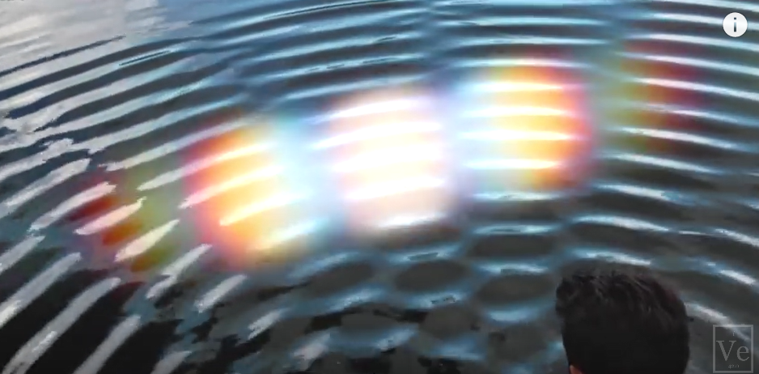
Is Light a Particle or a Wave?
After watching the video, answer the questions again:
What is Visible Light?
How does Light Travel?
Did the video change the way you think about light? If so how?
Notes:
After watching the video have students answer the questions again. Did their answers change? Check for understand and field any questions.

Slide 6
Visible Light and Electromagnetic Waves:
Visible Light is a Part of the electromagnetic wave spectrum
Light is composed of particles called photons that move in waves.
Colors you see are from wavelengths reflected off matter and to your eye.
Notes:
Discuss the key points on the slide. Point out to students what a small sliver visible light is of the electromagnetic spectrum.

Slide 7
Visible Light and Electromagnetic Waves:
Light and electromagnetic waves do not require a medium to travel.
Light and electromagnetic waves travel at 299,792,458 m/sec or approximately 3.00×10⁸ m/sec
speed of light = frequency times wavelength
Notes:
Review properties of the visible light and electromagnetic waves.

Slide 8
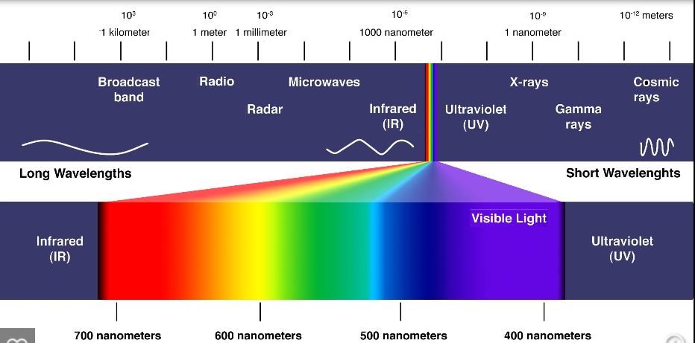
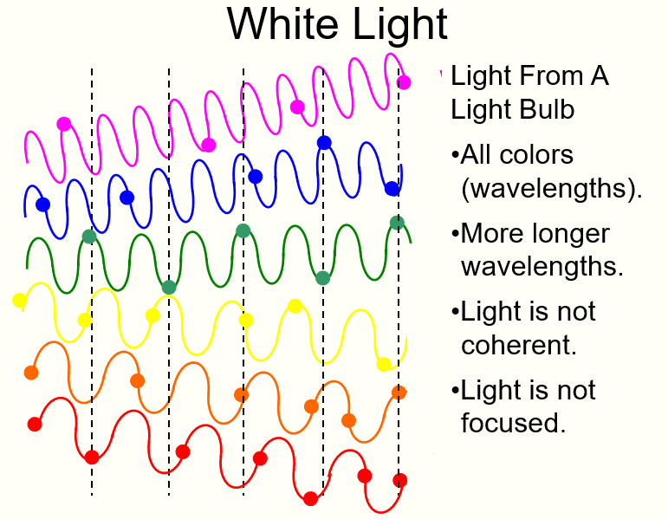
Visible Light:
Visible Light has wavelengths between 400 to 700 nanometers.
Notes:
Notice all of the different wavelengths that make-up white light. Each color has a different wavelength. From the diagram comparing red light to blue light which color has the highest frequency? (Blue) Comparing red light to blue light which color has the longest wavelength? (Red) Allow students time to answer the questions on their worksheet.

Slide 9
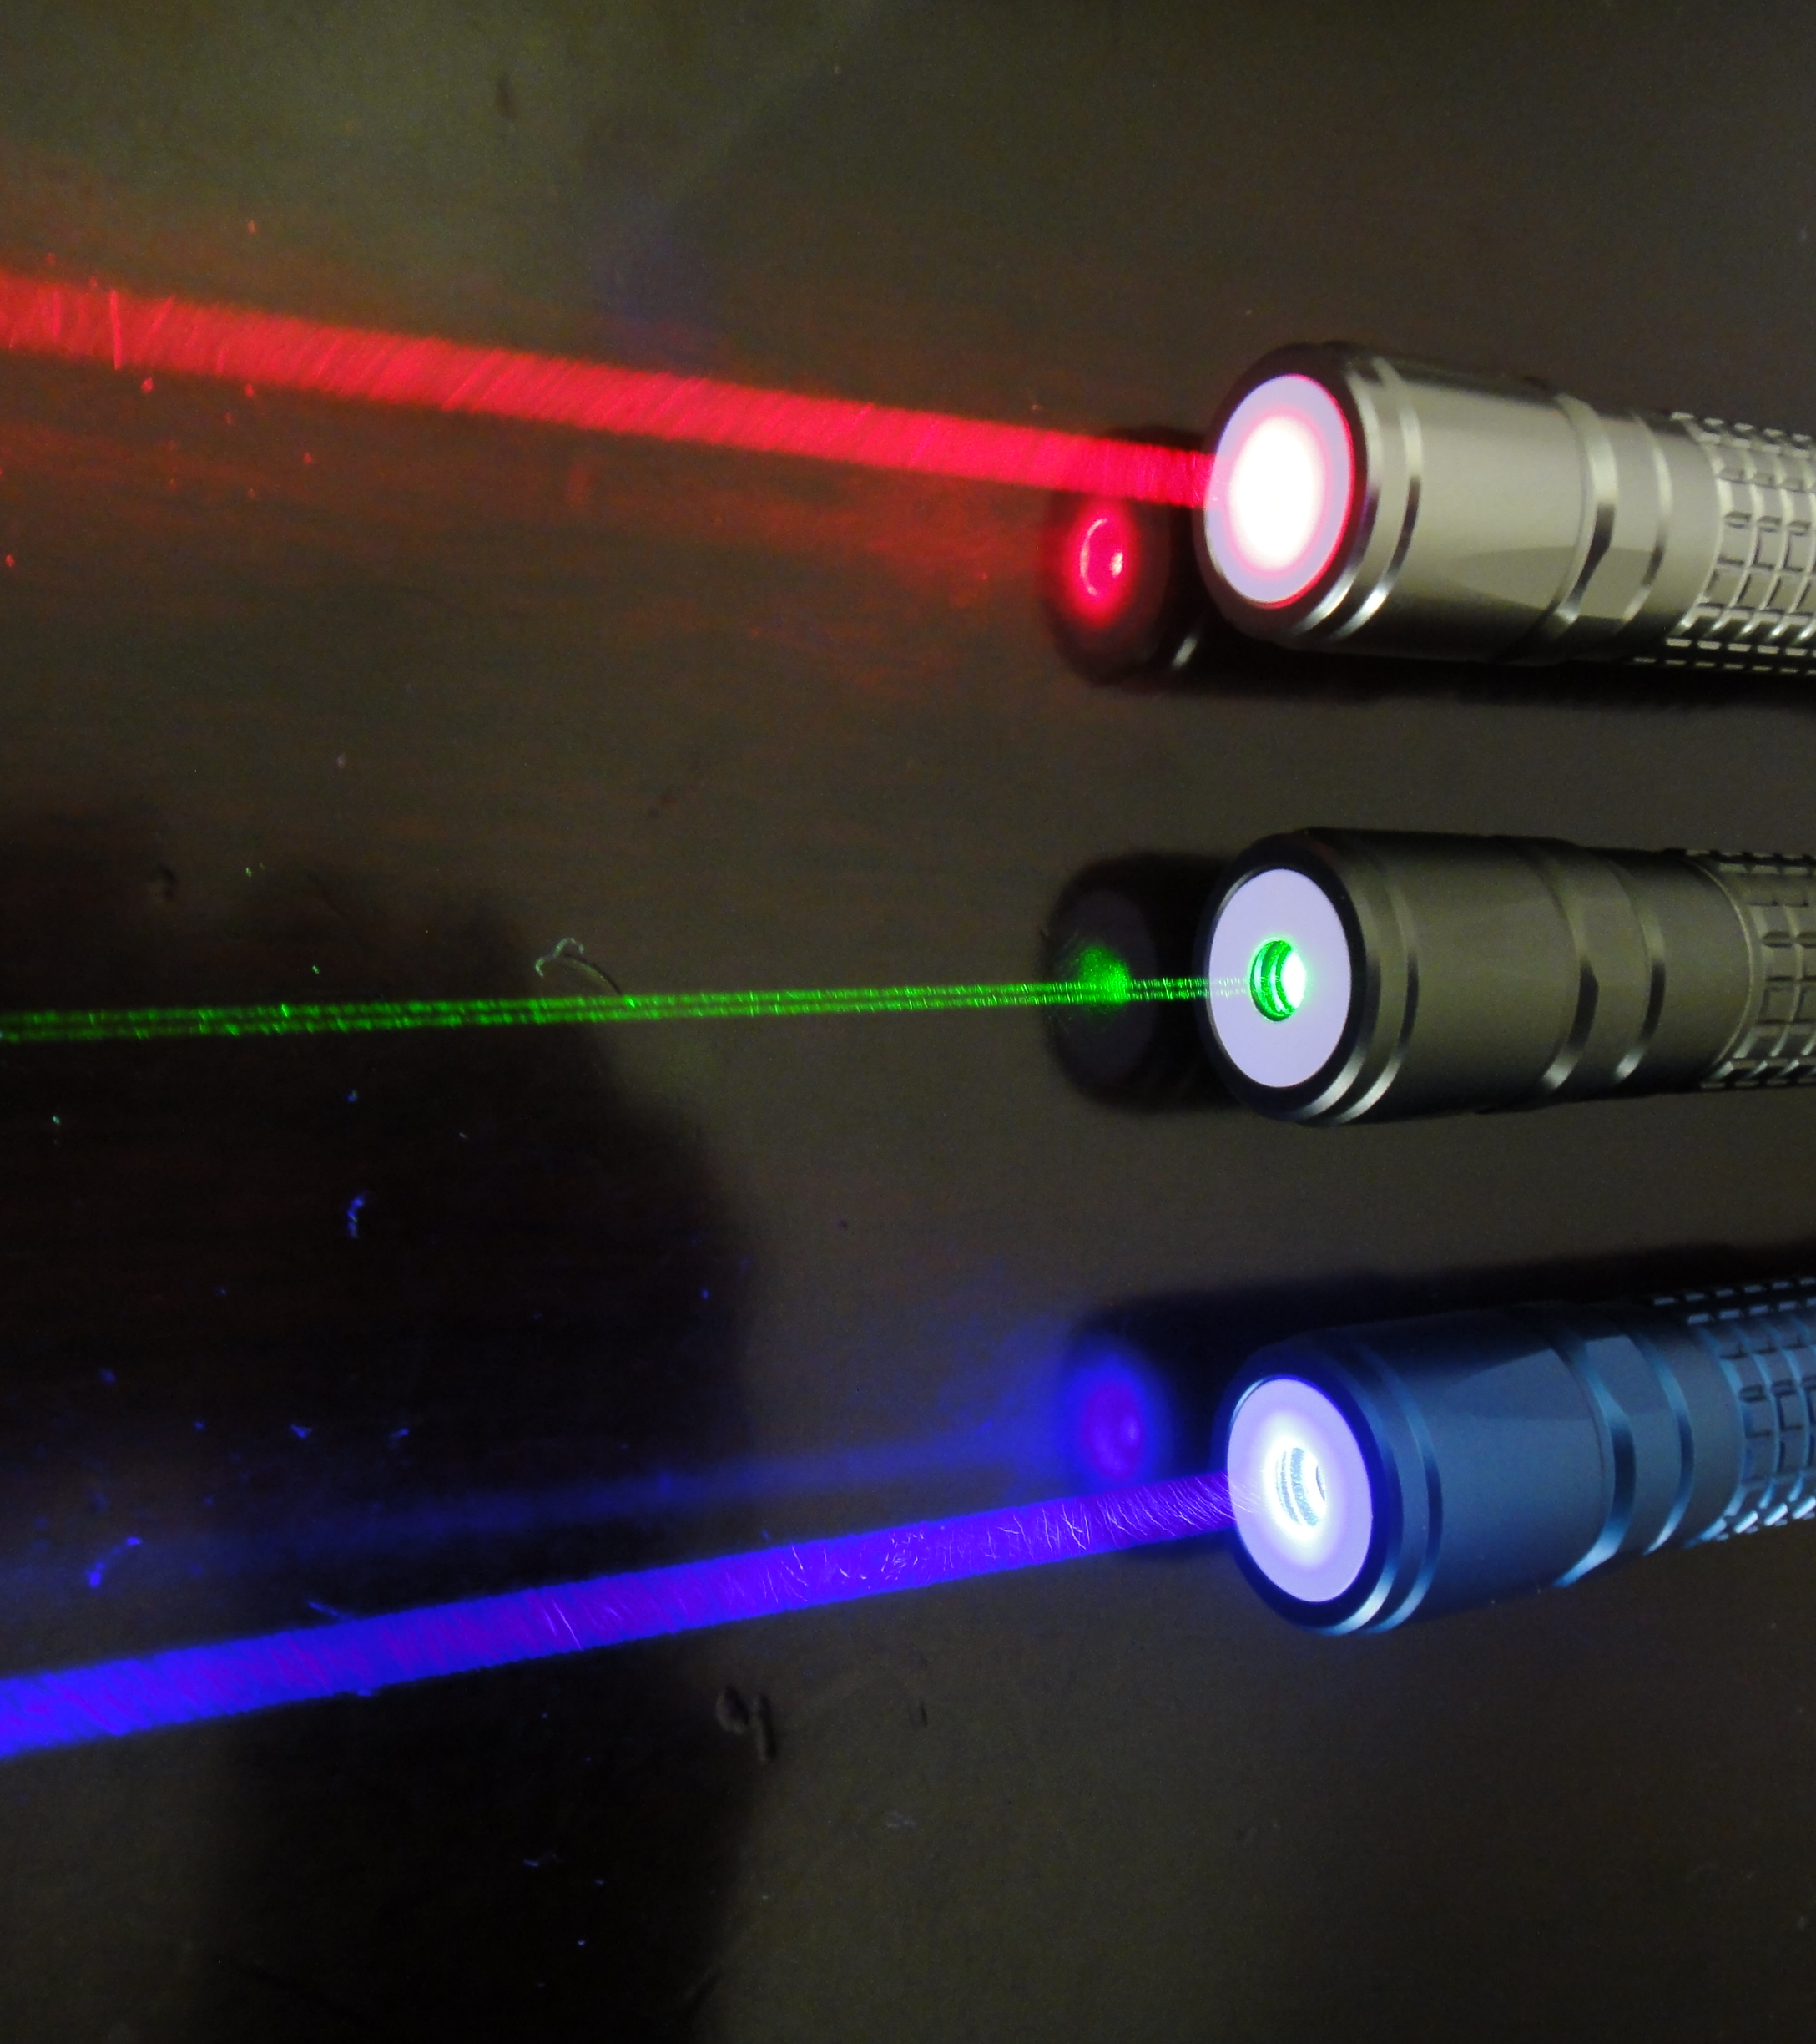
How does a Laser Work?
Write the question below in your journal and answer or use a provided student worksheet.
How does a laser work?
Write your answer based on what you know.
Notes:
Read the questions out loud and ask students to write the answers to the questions on their worksheets.

Slide 10
How a Laser Works?
Presented by Engineerguy
Click on the Picture to view the video clip
Notes:
Tell students we are now going to watch the video, “How a Laser Works?” and show the video.

Slide 11
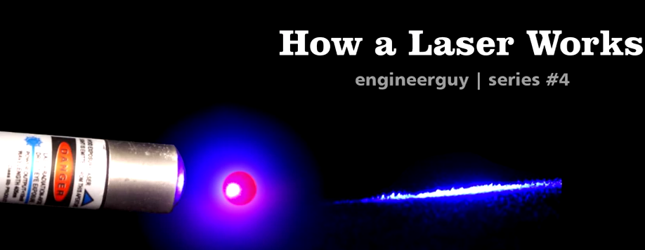
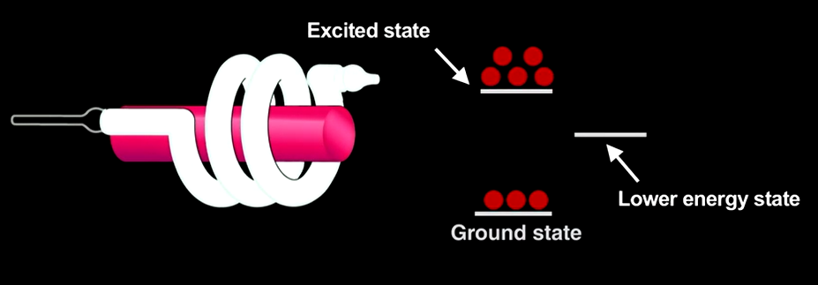
How does a Laser Work?
After watching the video, answer the question again:
How does a laser work?
Did the video change the way you think about lasers? If so how?
Notes:
Discuss the questions with students and have them write their response on their worksheet. There is a key supplied for the teacher.

Slide 12
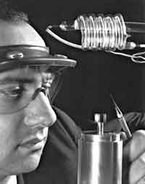
Light of a Laser:
Originally LASER was an acronym for :
Light
Amplification by the Stimulated Emission of Radiation.
Theodore H. Maiman called “the father of the electro-optics industry invented the working laser in 1960
Notes:
Read through the information for students ask them what the notice about all of the wavelengths shown. (All the wavelengths are the same and the light is coherent light) Provide time for students to answer the questions on their worksheet.

Slide 13
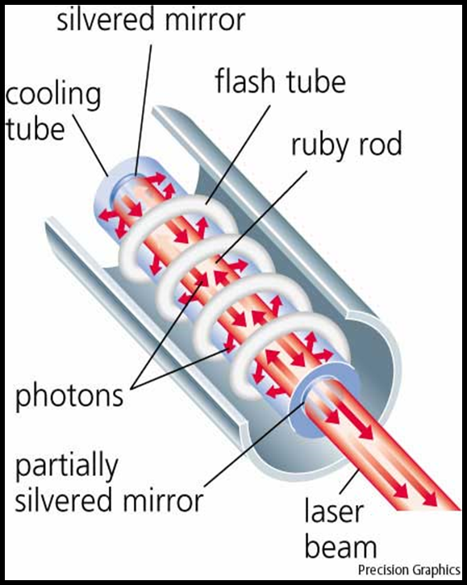
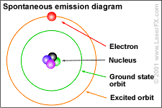
Light of a Ruby Laser:
1. Photons from an external source strike atoms in the rod
2. Atoms release more photons (stimulated emission of radiation) which strike other atoms continuing the process (amplification)
3. Coherent focused photons leave the rod through a slit in the mirror.
Notes:
Discuss the key points on the slide and point out the photon being release on the animated gif. Provide time for students to answer the questions on their worksheet.

Slide 14
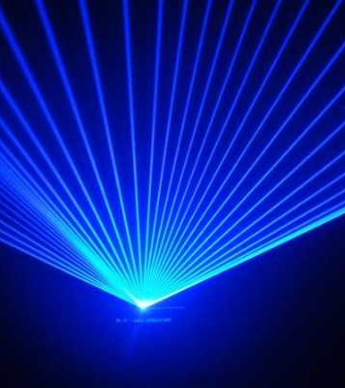
What are some Industry Applications for Lasers?
Write the question below in your journal and answer or use a provided student worksheet.
What are some uses of lasers in industry?
Did the video change the way you think about lasers? If so how?
Notes:
Review the questions and allow students to write down what they know about Industry applications for Laser.

Slide 15
How Lasers Work and Use in Industry
Presented by
Photomachining.com
Click on the Picture to view the video clip
Notes:
Tell students it is time to watch the video How Lasers Work and Use in Industry. Show the video by clicking on the picture.

Slide 16
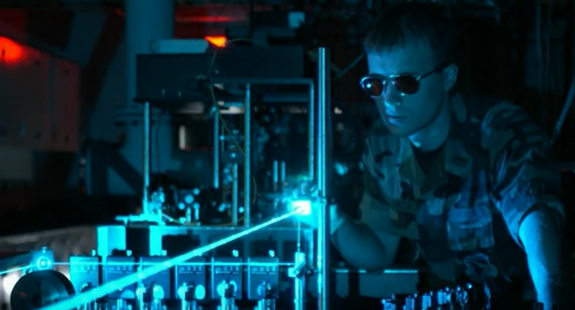
What are some uses of Lasers in Industry?
After watching the video Answer the question again.
What are some uses of Lasers in Industry?
Did the video change the way you think about lasers? If so how?
Notes:
Read the questions out loud and allow students time to answer questions on their worksheet.

Slide 17
Essential Guiding Questions:
What is Light?
How does Light travel?
How does a Laser Work?
What are Industry Applications for Lasers?
Notes:
Review the Essential Guiding Questions with students and check for understanding.

Slide 18
Cited Resources
Youtube: Veritasium: The Original Double Slit Experiment
https://www.youtube.com/watch?v=Iuv6hY6zsd0
The Physics Classroom
http://www.physicsclassroom.com/
Power Point from Technology Education Scarsdale Middle School
Link
Youtube: Engineerguy: How a Laser Works
https://www.youtube.com/watch?v=oUEbMjtWc-A
How Lasers Work and Use in Industry
https://www.youtube.com/watch?v=cJgViCkzg8o
Best animations.com
http://bestanimations.com/
Notes:
These are the resources that were used to research this power point.

Slide 19
Nanoscale Measuring of Diffraction Patterns with a Laser
Outline of Module:
“Nanoscale Measuring of Diffraction Patterns with a Laser”
Background Power Point:
Introduction to Light and Lasers
Measuring with a Laser
Activity: How Thick is My Hair?
Activity: Are All Cell Phone Faces Created Equally?
Notes:
Now that you know a little more “Of Light and Lasers Here is an outline of the activities in this module.

